Slide 1
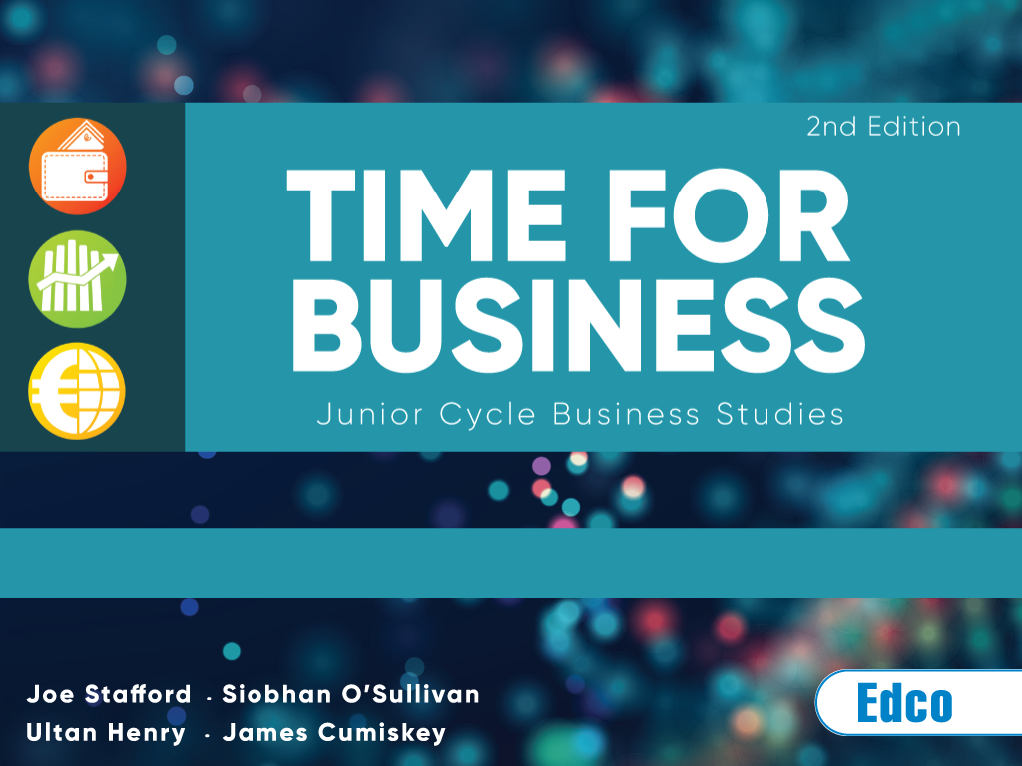
Chapter 24: Writing a Business Plan

Slide 2
Chapter 24
Learning intentions
In this chapter you will learn to:
Carry out a SWOT analysis
Outline the purpose of a business plan
Identify the main headings in a business plan
Complete a business plan for a new or existing product or service.
Textbook page reference: 283

Slide 3
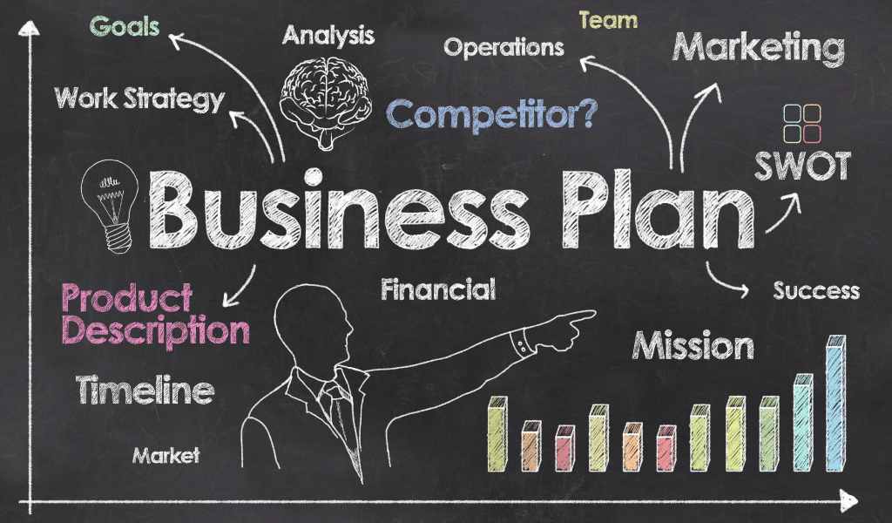
Chapter 24
The business plan
A business plan is a written description of a business’s aims, strategies, target markets and financial forecasts. It explains what the business plans to do and how it plans to do it.
Textbook page reference: 284

Slide 4
Chapter 24
The purpose of a business plan
Establish whether the business is likely to succeed
Help the business raise the finance it needs
Set targets to be achieved
Help the entrepreneur to focus on the future goals of the business to benchmark future profits and/or growth targets
Support a proposed expansion or the development of a new product or service
Textbook page reference: 284

Slide 5

Chapter 24
Section 1: Background of the business
The name and address of the business
The aims and objectives of the business
What products/services it will provide.
Textbook page reference: 284

Slide 6

Chapter 24
Section 2: The business team
The people involved in the business, including their educational details and past experience.
Textbook page reference: 284

Slide 7

Chapter 24
Section 3: Market and marketing
A brief description of the market
The current and potential size of the market
The number of competitors already in the market
The marketing mix strategy.
Textbook page reference: 285

Slide 8

Chapter 24
Section 4: Production
An outline of all premises and equipment available to the business
The production process to be used, e.g. job, batch or mass.
Textbook page reference: 285

Slide 9
Chapter 24
Section 5: Costings and finance
How much it costs to produce the item and what mark-up/profit margin will be added on to get the price it will be sold at
Details about any existing loans that the business has
The amount of finance required and the purpose for which it is needed
How the finance is to be repaid
Detailed cash flow forecasts and projected profits for two or three years.
Textbook page reference: 285

Slide 10

Chapter 24
Section 6: Structure of the business
The legal structure of the business, e.g. sole trader, partnership, private limited company, franchise.
Textbook page reference: 285

Slide 11

Chapter 24
Planning
Planning involves setting goals for the business and deciding on ways to achieve these goals.
Textbook page reference: 285

Slide 12
Chapter 24
Planning
When setting goals, always remember that they should be SMART:
S | Specific | Define a specific, clear goal.
M | Measurable | It must be possible to measure whether or not the goal has been achieved.
A | Agreed | Goals are much more likely to be reached if they are agreed and accepted by all those involved in achieving them.
R | Realistic | It must be possible to achieve the goal using the resources available.
T | Timed | This gives the goal a target date to be achieved by.
Textbook page reference: 285

Slide 13
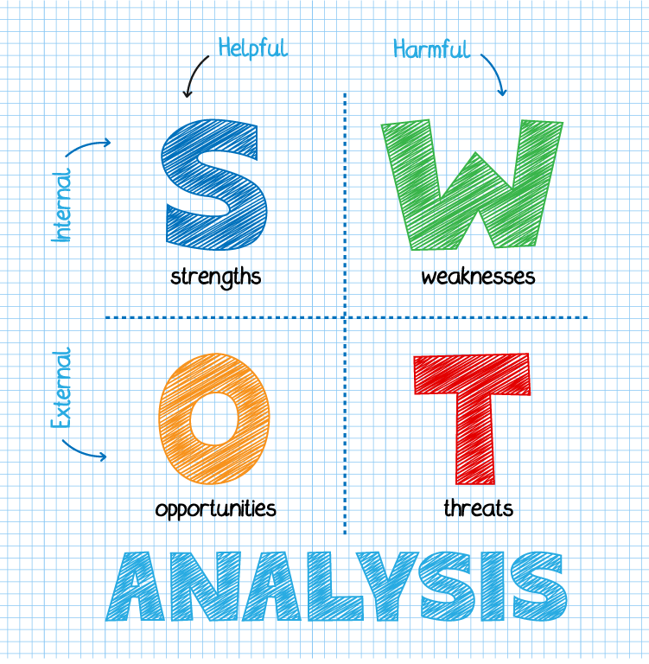
Chapter 24
SWOT analysis
A SWOT analysis identifies the current strengths and weaknesses of a business as well as the opportunities and threats facing it.
Textbook page reference: 286

Slide 14
Chapter 24
Forms of business ownership
Sole trader
  This business is owned and managed by one person.
Partnership
  A partnership is created when 2–20 people set up in business.
Private limited company
  A private limited company is a business set up by between one and 149 people, called shareholders.
Textbook page reference: 287

Slide 15

Chapter 24
Franchises
A franchise is when one firm (the franchisor) sells the right to use its products and its brand name to another business (the franchisee) in return for a fee and a share of the profits.
Textbook page reference: 287

Slide 16
Chapter 24
Advantages of franchises
The idea already exists, so the entrepreneur can look at the track record of the existing business and see if the product/service works
The brand name may be well established
The franchisor provides support and training, so the franchisee benefits from the franchisor’s guidance, training, products and equipment
Costs such as marketing can be shared between the franchisees.
Textbook page reference: 288

Slide 17
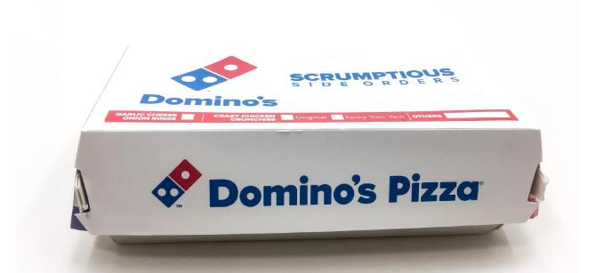
Chapter 24
Disadvantages of franchises
A negative response to one franchisee might affect them all
Franchisees must follow strict rules when operating the business, so there is a loss of control.
Textbook page reference: 288

Slide 18
Chapter 24
Recap and review
Can you?
Carry out a SWOT analysis
Outline the purpose of a business plan
Identify the main headings in a business plan
Complete a business plan for a new or existing product or service.

Slide 19
Chapter 24
Credit slide
Shutterstock

